Slide 1
Stay Recommendations Programming for Big Data Analytics
Dhaval Patel (djp526)
Vishnu Thakral (vvt223)
Yash Rathod (yhr208)
Guided by : Prof. Juan Rodriguez

Slide 2
Problem Statement
Account for safety of the neighborhood and nearby facilities to recommended stay for the guest.
Predict rating for relatively new and unrated listings, thus bringing up the value of listings with good score potential.
2

Slide 3
Datasets used
Airbnb’s Listing Dataset : 50k (Active Listings in NYC)
NYC Crime Stats : 66M (10 years)
NYC Restaurant Dataset : 3M
3

Slide 4
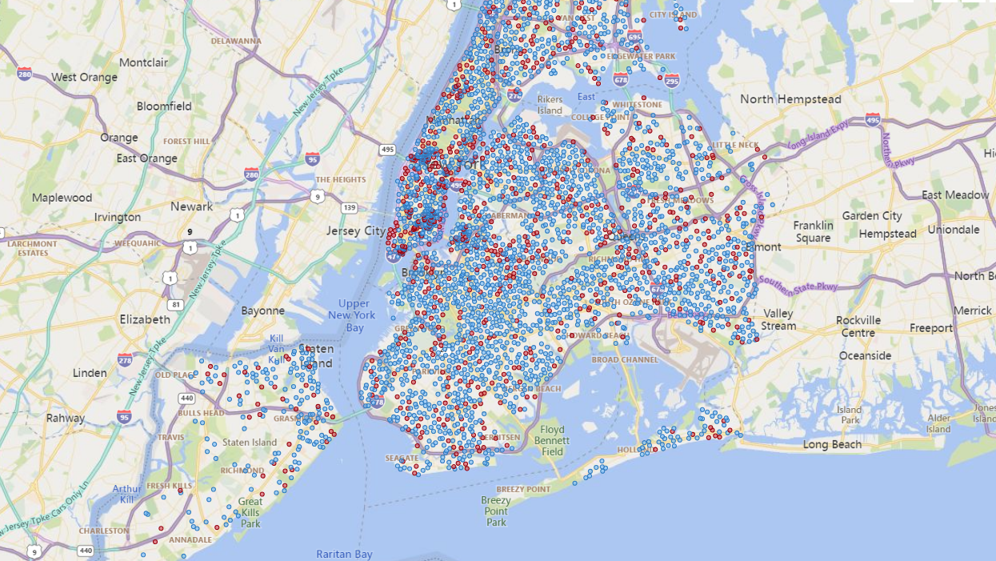
Insights on Airbnb’s listing Data (NYC)
Total available current listings : 50K
Total number of listings with less number of reviews/ratings( <15 ): 22K
Average New Listing added per month : 3K
4

Slide 5

Methodology
Present Month’s Listed Properties
Airbnb’s Listing Data
(Last 12 months)
Trained Model
(Logistic Regression)
Airbnb listings with crime and nearby facilities based on Geo-location
Reporting Insights using Power BI and Building Custom User Interface
Pre-Processing
Feature Extraction
& Training
NYC Crime-stats Data
Listings with Updated Ratings
NYC Restaurant Data
5

Slide 6
Methodology
To get our training Dataset, we collect AirBnb’s Last 12 Month’s Datasets and combine them by taking only unique listings and get over 72K unique Listings for our training.
After this, there is some data-cleaning done that removes the Null-Valued/Zero-Valued entries, and also converts into required Datatypes.
This clean data is further processed to combine the Crime Stats and Restaurant Stats Dataset based on Geo-Coordinates.
This final Data will now be used for developing and testing a Logistic Regression Model.
6

Slide 7
Pre-Processing
Airbnb’s Listing Data
(Last 12 months)
Cleaned data with Unique Listings
Join based on geo-location
(To get crime-stats and restaurants within 0.5 miles of the property)
Logistic Regression
For Training
NYC Crime-stats Data
NYC Restaurant Data
7

Slide 8
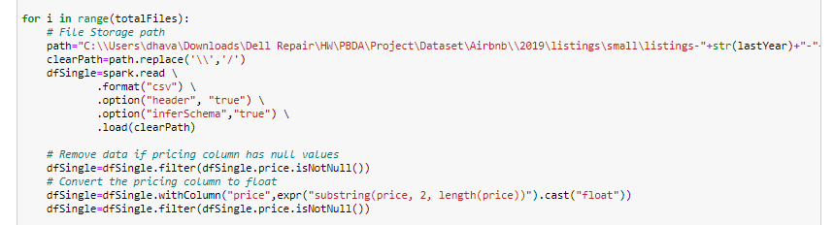
Pre-Processing – Task 1
To get more data in our training Dataset, we have to do the preprocessing work. In this step we collect AirBnb’s Last 12 Month’s Datasets and combine them.
To combine these listings, we take the November month’s Listings and add all into our training DataSet. Now, the October month’s listings will have a majority of them which are already present in November’s Data. So we only take the unique values in October which were not present in November (Properties which have been delisted / discontinued on Airbnb in October).
8

Slide 9
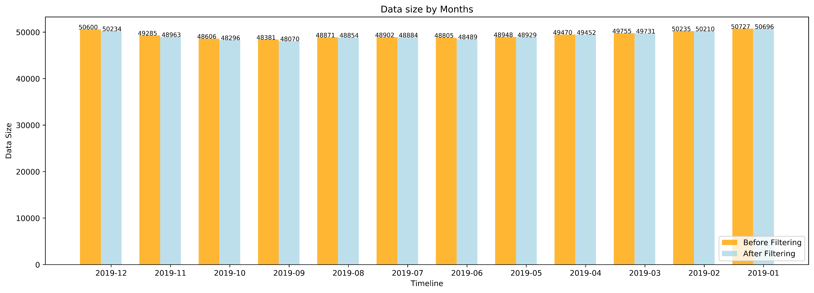
Pre-Processing – Task 1
Displaying loss in data per month after removing null pricing values
9

Slide 10
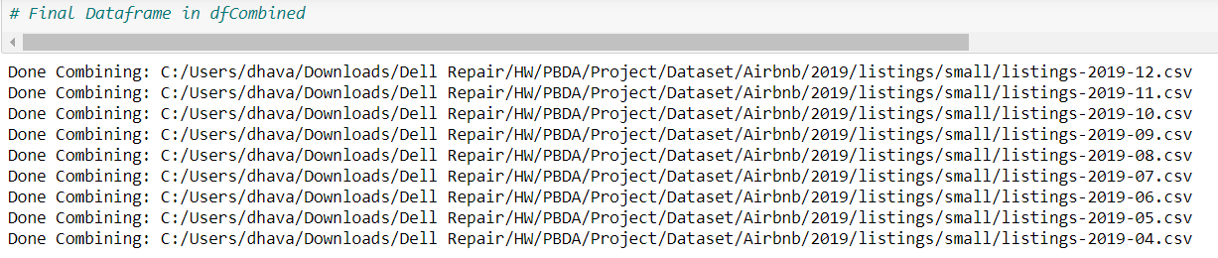
Pre-Processing – Task 1
This iteration is performed over 12 months Data. To get more data for our training datasets, we can take 2018, 2017 data…. And keep adding to our final training dataset.
Printing and displaying the files that have been successfully combined
10

Slide 11
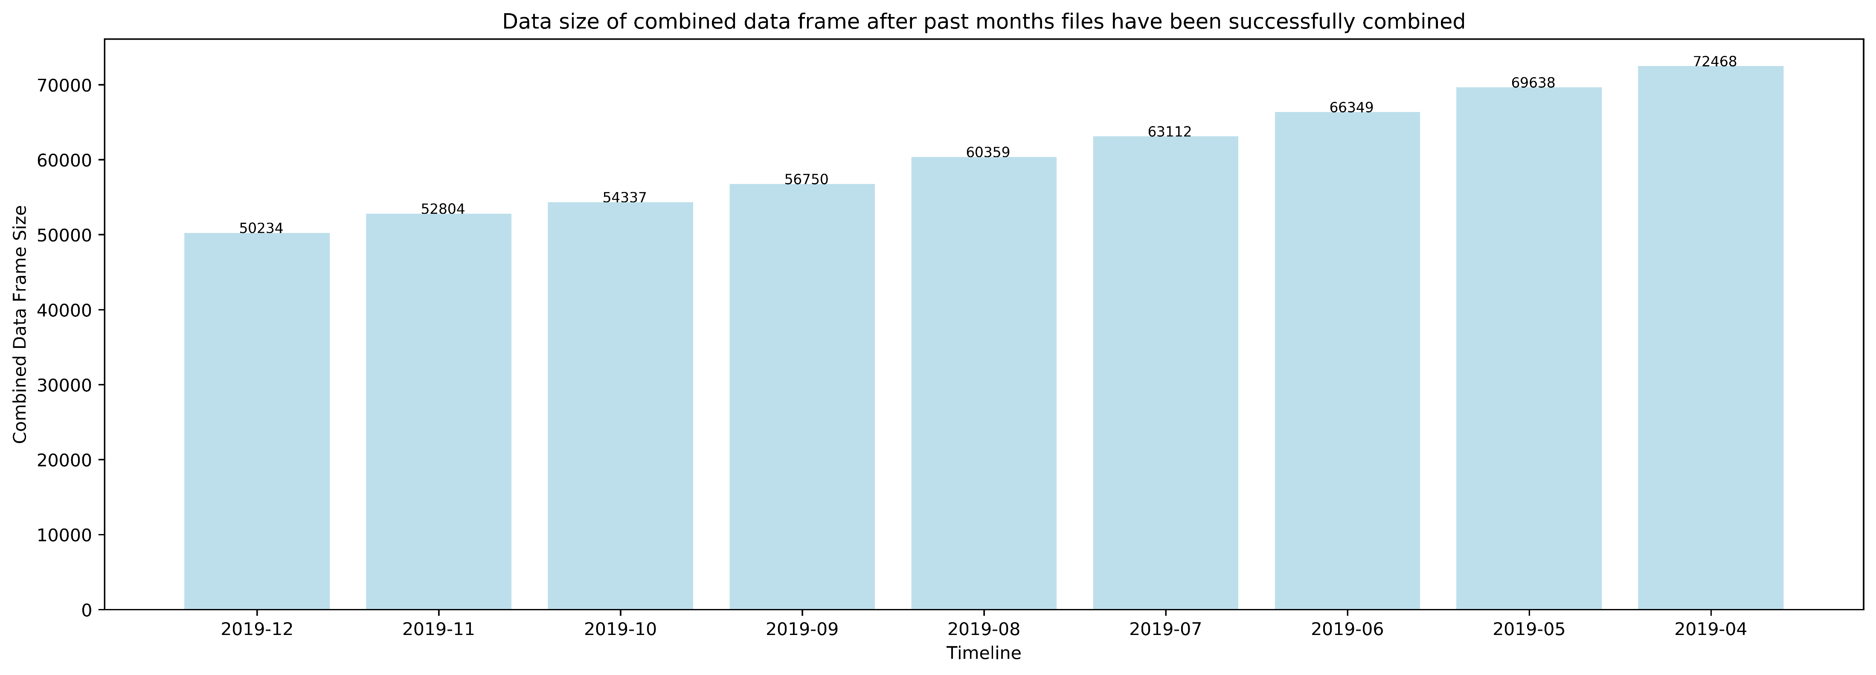
Pre-Processing – Task 1
Displaying the size of combined data frame after past months files have been successfully combined
11

Slide 12
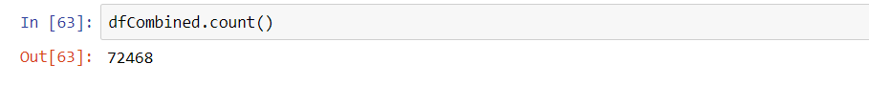
Pre-Processing – Task 1
We did this iterative process for 12 months, to get a combined data of over 72K Unique Listings
Now this Dataset is further processed to combine the Crime Stats and Restaurant Stats Dataset based on Geo-Coordinates
12

Slide 13
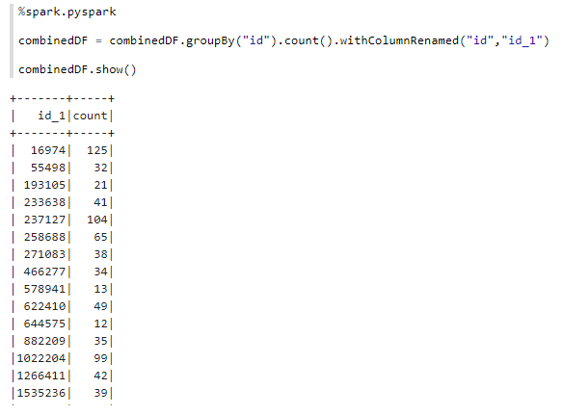
Pre-Processing – Task 2
After merging the Airbnb Listing Data of the last 12 months, we clean it further by removing the Null Valued/Zero Price Entries and changing the datatype of many columns to Integer / Float DataType as required.
Now, after cleaning, we first combine the Airbnb DataSet with the Crime Stat DataSet. Using the geo-coordinates we count the number of criminal activities reported withing a 0.5Km radius of each listing.
13

Slide 14
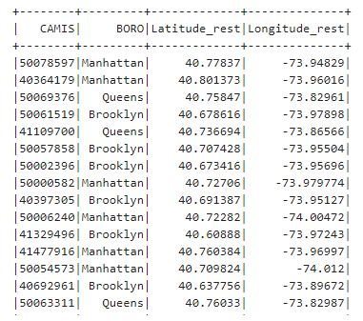
Pre-Processing – Task 2
We perform similar set of operations to clean the restaurant dataset
After cleaning, we combine the Airbnb Dataset with the Restaurant Stats Dataset. And again using the geo-coordinates date we count the number of restaurant and facilities withing a 0.5Km radius of each listing.
We then combine, the above two counts (Restaurant and Crime Stats) for each listing.
Restaurant Data After Cleaning
14

Slide 15
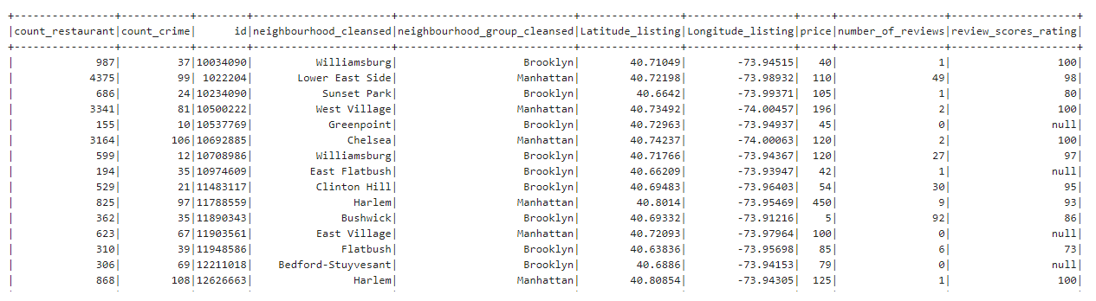
Dataset after Pre-Processing:
The Final dataset has the required count data as shown below. This Data has more than 72K records and will be now sent to train and built a Machine Learning model.

Slide 16
Model Training and Prediction (Flow)
Listings with >15 reviews/ratings
Feature Extraction
& Training
Join based on geo-location
(To get crime-stats and restaurants within 0.5 miles of the property)
Listings with ≤ 15 reviews/ratings
Model
Prediction
(Updated Rating)
Accuracy
Transform
16

Slide 17
Model Training - Task 3
After preprocessing (removing rows with null for price), we use three features to train our model so as to be able to predict the appropriate value of rating for newly added/ less reviewed listings.
1. "count_crime", this attribute has the count of crime that have occurred in the past near to a listing
2. "count_restaurant", this attribute has the count of restaurants close to a particular listing.
(within a distance of 0.5km)
3. "price", the attribute has the value of average price of the listing from the time it has been listed
4. "review_Score_ratings", this attribute is used as the target/output for the model and is fed to the model in rounded form of nearest multiple of 5 thus having 20 bins/classes of label 5,10,15...100.
We used Naïve Bayes and logistic regression for the ML model but the accuracy of Naïve Bayes was poor as it did not consider the fact that there would be relation between the customer review and the crime stat in the locality or rating of customer and the restaurant nearby.
As the naïve bayes accuracy was low we stuck to logistic regression.
Feature column is made as a vector from the features described above and given as an input to the Logistic Regression model

Slide 18
Prediction - Task 3
Taking only the data entries which have review count >=15, we train the model on 75% of this selected data and test on the remaining 25%.
Once the prediction accuracy is obtained we use the coefficients obtained from the model to add value for the review_rating_score for the listings with null/reviews less than 15.
The updated data is saved and used to give listings as per the customers search.
The accuracy is predicted using the Multi class classification evaluator of Pysprak.ml.evaluation library.
The accuracy of the model is around 80-85%.

Slide 19
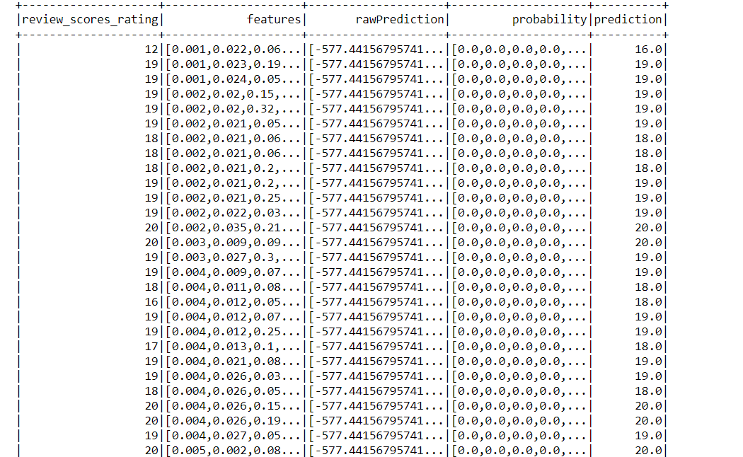
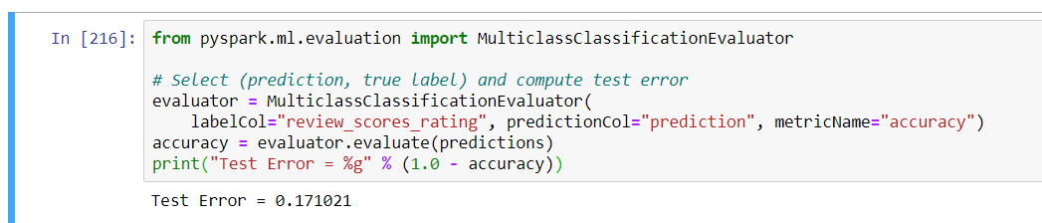
Dataset after Prediction:

Slide 20
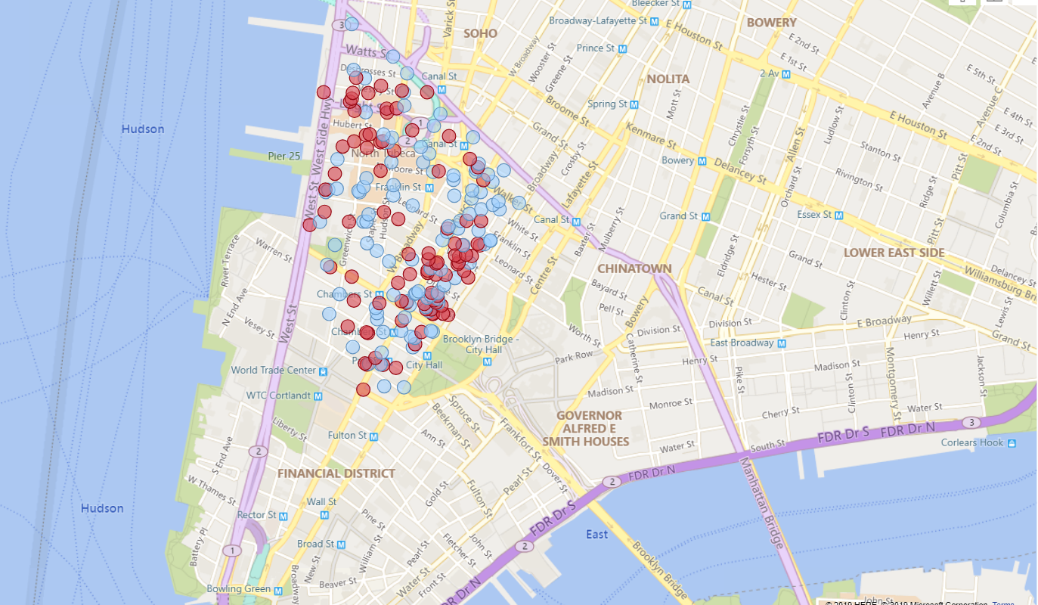


Power BI Map Visual
Area:
Tribeca, Manhattan
Listings with more than 15 reviews
Listings with less than 15 reviews
Listings with more than 15 reviews
Listings with less than 15 reviews

Slide 21
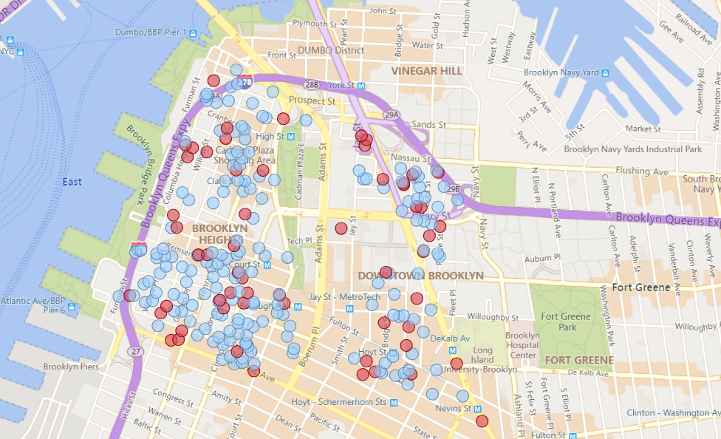
Power BI Map Visual
Area:
Downtown Brooklyn & Brooklyn Heights
Listings with more than 15 reviews
Listings with less than 15 reviews

Slide 22
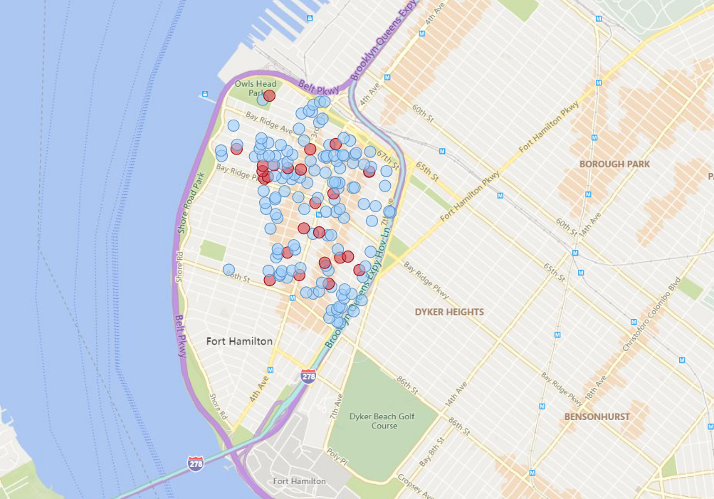
Power BI Map Visual
Area:
Bay Ridge, Brooklyn
Listings with more than 15 reviews
Listings with less than 15 reviews

Slide 23
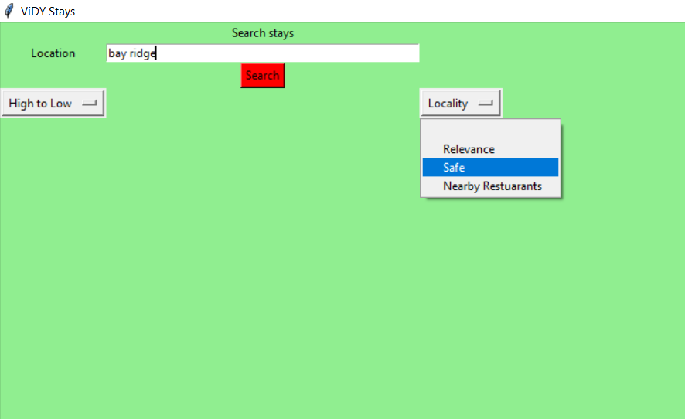
Demo
User Interface

Slide 24
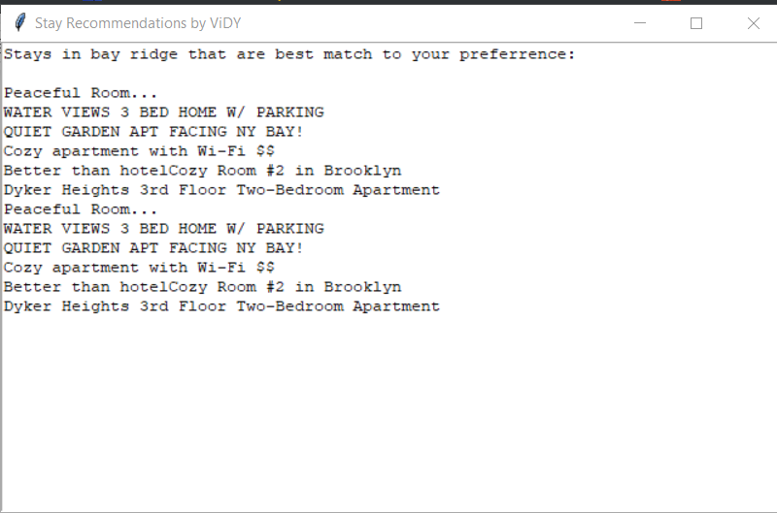
Demo
Search Output

Slide 25
Scalability in Production Environment
We limited our computations only for Airbnb listings in NYC, but organizations like Airbnb has its presence all around the world.
If this project were to be implemented on a large scale by an organization like Airbnb, it will have to build a prediction model for each of its city separately.
This training and prediction should be specific to every city because every city has different statistics specific to it.
Also, as we saw on an average more than 3K new listings get added in NYC every month, this model training & rating prediction task can be on a bi-weekly basis for each city.

Slide 26

Questions?

Slide 27
Thank you!

